Slide 1
ASP.NET MVC Bootstrapper
A enterprise development framework which can developer’s life.
By Md. Alim Ul Karim

Slide 2
Topics
Why do we need such framework?
What it’s purpose?
How it is going to solve problems?
Where it is going to fit?
Who is going to use it?
How we are going to install it?
Proof of concepts comparing with another regular project
Example and test cases.
References

Slide 3
Why do we need such a framework?
Necessity
Time
Remove repeating task
Keeping a close relationship between engineers and developers.
“A true creator is necessity, which is the mother of our invention.” - Plato
One thing that we can’t multiple is time, it is the most valuable asset that one can have.
Last thing we have to remember that humans are not machine.

Slide 4
How it is going to solve the problems?
Efficiency
Faster results
Great UX and UI
Rich user registration system
Error logs on each occurrence.
“Efficiency for large scale users.”
“best practice is a method or technique that has consistently shown results” - wikipedia
Rapid development with efficiency.

Slide 5



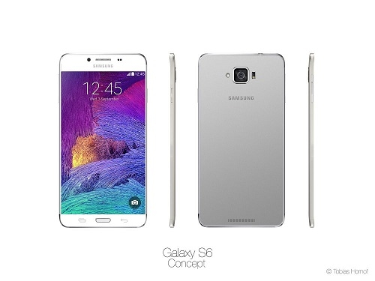
Technology
Seems like modern
If we are happy then …
It’s not the cutting edge ever!

Slide 6





3-Tier Architecture
Presentation Layer
Business Logic
Data Layer
Software
Seems like modern
browser
WebSite
OS: Linux/Windows Server…
Server: Apache/IIS Web Server…
PHP/.NET Framework/JDK…
SQL Server / Oracle/MySQL
Client Tier/Client Machine
Middle Tier/Application Server
Database Tier/Database Server
Client Tier : Operating System (Windows 95/98, Linux)
Web browser : (Internet Explorer 9.0/Google Chrome)
Components : Flash/.NET/JRE/SilverLight….
Database Tier: MySQL Server/ SQL Server/Oracle etc….
Middle Tier: Linux/Windows operating system
Apache/IIS Web Server
Scripting Engine PHP,ASP etc…
Notes:
You are not giving your presentation to have another meeting. You are there to covey meaning.

Slide 7
Let’s see Pure MVC vs Framework
Bootstrapper MVC
Pure MVC
Centralization and configuration.
Great registration system.
Less additional frameworks
Faster integration
Web Optimization Out of the box (YSlow)
Robust scaffolding.
Tons of components (Combo, DateTime…)
Cache things out of the box.
DevMvcComponent integration.
IP to country detection.
Javascript framework
And many more.
NO ! Centralization and configuration
No registration system.
NO ! Additional styling framework
NO ! Faster integration
NO ! Web Optimization is not integrated out of the box.
NO ! Robust scaffolding.
No existing component.
NO ! Cache things out of the box.
DevMvcComponent is not implemented.
NO ! IP to country detection.
NO ! Javascript framework
We have to make our own.
Let’s see demo with the framework’s installed version.

Slide 8
Javascript MVC Framework
Javascript MVC Framework
We can’t write Javascript in html.
Calling every method will make your application slow.
Developer might use selectors which are extremity slow.
There is no convention for each developer.
Lack of consistency.
Let’s see the framework.

Slide 9
Future plans
Future Plans
Version 1.0 is on the way consisting with a lot of new methods and new Uis
Version 1.0 will be implemented with DevMvcComponent 2.0.4.
Uploading Feature will be there as a out of the box.
The most updated timezone database integrated.
Large scale data fails to display with current UI components , new version will solve it.
Make a full-fledge CMS and blogging system like wordpress.
And many more features.

Slide 10
How to Install
Source Code
Test App
http://bit.ly/how-asp-boot
http://j.mp/asp-net-boot
http://wereviewapp.com

Slide 11
References
References
http://yslow.org
ASP.NET MVC Basics : http://bit.ly/1OtU7ow
Yslow Implementation : Bigger, Faster, Stronger: Optimizing ASP.NET Applications (http://bit.ly/1UO1uXB)
Don’t make me think (http://amzn.to/1OtU9wI)
Source code: http://j.mp/asp-net-boot
JavaScript Framework Code: http://bit.ly/1UO1M0L
JavaScript Framework how it is implemented : http://bit.ly/1KdWSHD | http://bit.ly/1KdX0qq
Lesshat : http://bit.ly/1KdX75o
Twitter Bootstrap : http://getbootstrap.com
DevMvcComponent : http://bit.ly/1KdXhd5
Presentation Codes : http://bit.ly/1OtTL1f

Slide 12
Thank you
Feedback
Questions ?
Presented by
Md. Alim Ul Karim
alim.karim.nsu@gmail.com
North South University
CSE 499

Slide 13
Thank you
Questions ?
Presented by
Md. Alim Ul Karim
alim.karim.nsu@gmail.com
North South University
CSE 499

